Slide 1
Equality of opportunity
Lecture 3
Discrimination

Slide 2
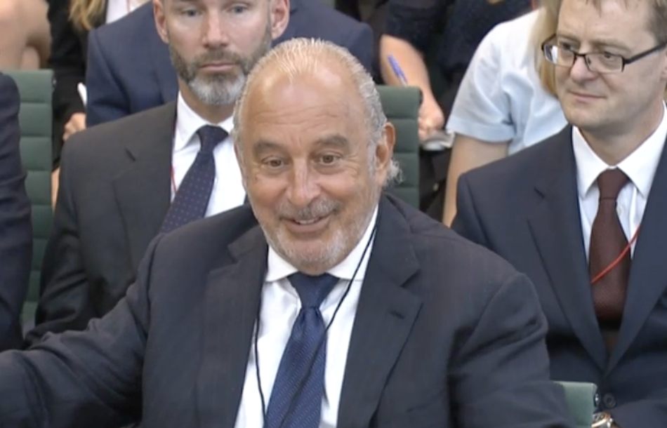
Discrimination
Sir Phillip Green -Used NDAs to keep discrimination secret
Tokyo Medical School – reduced the scores of women taking the entrance exam

Slide 3
Defining discrimination

Slide 4
What is discrimination?
Intuitive: not giving someone a job, position, or benefit on the basis of their race, gender, sexual orientation, etc.
More precise definition (Lippert-Rasmussen 2006):
X discriminates against Y in dimension W iff:
X treats Y differently from Z in dimension W;
the difference in treatment is believed to be disadvantageous to Y;
the difference in treatment is suitably explained by Y’s and Z’s being from different socially-salient groups.

Slide 5
“Socially-salient groups”
Socially salient group: A “group is socially salient if perceived membership of it is important to the structure of social interactions across a wide range of social contexts” (Lippert-Rasmussen 2006)
Examples: race, gender;
not eye colour
Why focus on socially
salient groups?
Answer 1. Pragmatism
Answer 2. We want to assess current practices, and current discrimination law focuses on socially salient characteristics

Slide 6
Discrimination in UK law

Slide 7
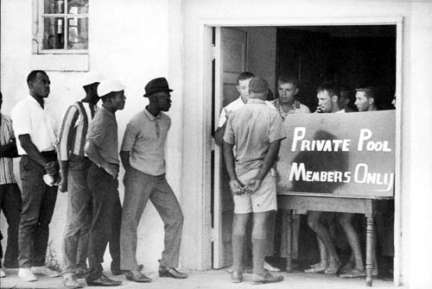
Discrimination beyond the law
Private discrimination:
Not always illegal – but still immoral? E.g.:
Private sports clubs
Religious associations
Discrimination in personal lives:
Is it wrong to choose friends, spouses, or romantic partners in terms of “protected characteristics”?
What about sexual preferences? (e.g. racialized sexual preference)

Slide 8
What is wrong with discrimination?

Slide 9
Harm and Discrimination
The Harm-Based Account: discrimination is wrong insofar as it makes those who are discriminated against worse off. (Lippert-Rasmussen 2006)
Worse off than…?
…how well off they would be if the discrimination had not occurred (Non-moralised baseline)
…how well off they would be in a just world (Moralised baseline)
(and worse off how? By what metric?)

Slide 10
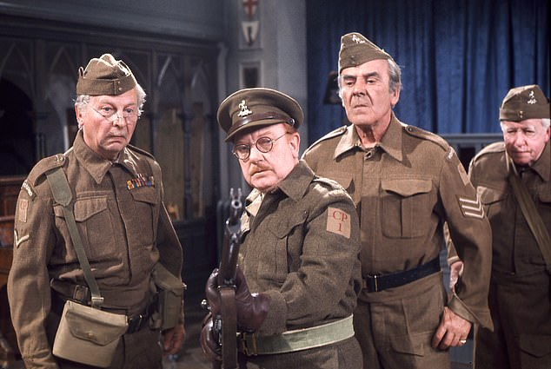
Harm and Discrimination
The Harm-Based Account: discrimination is wrong insofar as it makes those who are discriminated against worse off. (Lippert-Rasmussen 2006)
Problem: There are cases of wrongful but beneficial discrimination.
Example: gay men
prohibited from serving in the
army, who would have died in
combat

Slide 11
Bad Attitudes and Discrimination
The Bad Attitudes Account: wrongful discrimination is motivated by “unjustified hostile attitudes toward people perceived to be of a certain kind or faulty beliefs about the characteristics of people of that type” (Arneson 2006)
Problem: There can be wrongful discrimination in the absence of bad attitudes. E.g. George, who falsely believes that all Scandinavians are incredibly skilled.
Reply? George’s excessively good attitude toward Scandinavians entails an excessively negative view of non-Scandinavians.

Slide 12
Equality of opportunity and discrimination

Slide 13
Luck Egalitarianism and Discrimination
Luck egalitarianism (LE): We should eliminate inequalities in opportunities for welfare if they result from bad luck rather than from choice
LE could say: discrimination is wrong where it leads to luck-based inequality in opportunities for welfare
Advantage 1: LE can explain the
focus on socially salient groups.
Advantage 2: LE can succeed
where harm/attitude explanations
fail (Segall 2012)

Slide 14
Problems for the LE explanation
Problem 1: LE allows discrimination if properly compensated (Stark 2013)
Reply: Not all discrimination is wrong (Arneson 1999)
Counter: LE allows some forms of discrimination that seem intuitively wrong
Example: a caste society where a minority racial group is excluded from certain jobs but receives financial compensation (adapted from Stark 2013)
Reply: LE prohibits this because money cannot compensate loss of self-respect through discrimination (Segall 2012)

Slide 15
Problems for the LE explanation
Problem 2: LE would allow a society in which:
group A discriminates against B
group B discriminates against C
group C discriminates against A
so long as equality prevails
But such a society seems morally
problematic.
(adapted from Moreau, 2010)

Slide 16
Meritocracy and Discrimination
Meritocracy: desirable jobs or positions should be offered to the best-qualified applicants through competitions that no one is excluded from entering
Meritocracy would say: discrimination is wrong because it ignores qualifications
Advantage: Anti-discrimination is built into the foundations of meritocracy: qualifications are all that count
Implication: Legal definitions of discrimination are too narrow—we shouldn’t focus only on “socially salient groups”

Slide 17
Meritocracy and Statistical Discrimination
Statistical discrimination: a member of a socially-salient group G is treated worse because there is statistical evidence that members of G perform less well (Lippert-Rasmussen 2007)
Problem for meritocracy:
Statistical discrimination may be an efficient way of finding out whether an individual is qualified for a job.
But statistical discrimination seems unfair.
So meritocracy seems to encourage an unfair form of discrimination.
Reply: statistical discrimination is unfair when it does not accurately track merit

Slide 18
Meritocracy and Reaction Qualifications
Reaction Qualification: an attribute that contributes to job performance because of the reactions/attitudes of other people
Example: in a racist society, being white may be a qualification for a car salesperson because of customer prejudice (Miller, 1999)
Problem for Meritocracy: when qualifications result from discriminatory attitudes, selecting the best qualified becomes a channel for discrimination.

Slide 19
Defending Meritocracy
Problem: reaction qualifications can legitimate discrimination
Reply 1: Reaction qualifications should never count when we are selecting the best qualified
Counter 1: in many cases, taking reaction qualifications into account is legitimate for meritocracy (for example: teaching, sales, acting)
Reply 2: reaction qualifications count only if they are based on morally legitimate attitudes. (Miller 1999)
Counter 2: it is no longer meritocracy itself that explains the wrongness of discrimination—rather, it is some prior standard of moral legitimacy

