Slide 1
Political obligation
Week Three: Fair play and natural duty
Matt Bennett
mpb74@cam.ac.uk
drmattbennett.weebly.com

Slide 2
Fair play theory
Basic principle:
it’s only fair that individual citizens pull their weight
Think e.g. of a houseshare dishwashing rotation
I have benefitted from others washing my dishes
When it comes to be my turn, it’s only fair that I do my part

Slide 3
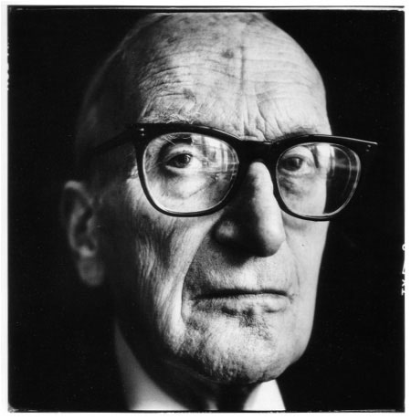
Fair play theory – Hart’s analysis
H.L.A. Hart:
Others have a right to compliance from me in virtue of 2 facts
They have contributed to a joint enterprise
I have benefitted from that joint enterprise
Non-utilitarian
Not consent based

Slide 4
Free riders
Free rider: someone who transgresses another’s right to their compliance or contribution to a joint enterprise
Contrast with
Nervous cooperator: desires to contribute, but does not because they fear for the stability of the enterprise
Reluctant cooperator: desires to contribute, but does not on the grounds that they expect others to unfairly benefit without contributing
(According to Arneson) only free riders are blameworthy because they intend to benefit from the cooperation of others without themselves cooperating

Slide 5
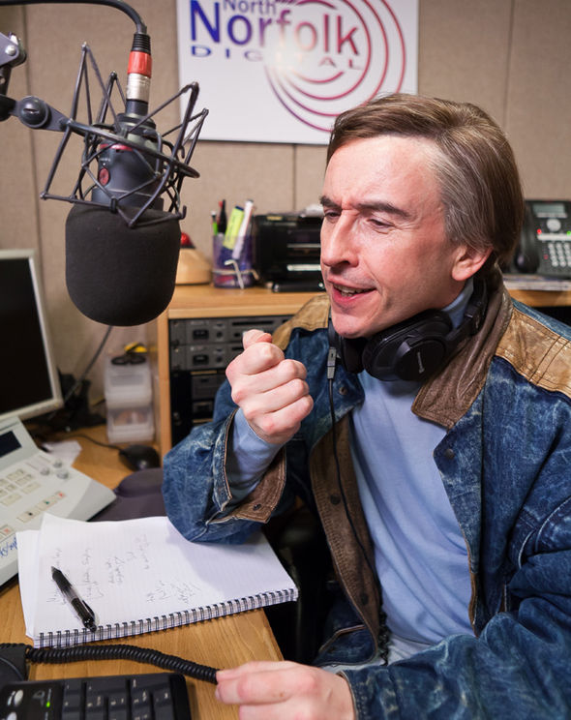
Nozick’s Public Address System
FPT: Others have a right to compliance from me in virtue of 2 facts
They have contributed to a joint
enterprise
I have benefitted from that
joint enterprise
But what if I didn’t agree to the
enterprise or to receiving its benefits?
E.g. Nozick’s public address system

Slide 6
Initial replies to Nozick
The benefit in Nozick’s example is so meager as to render contribution-costs unreasonable to most people
Thus further caveat for FPT:
We are obligated to contribute to a joint enterprise from which we have benefited where the benefit from the scheme is greater than the cost
But surely some will benefit more from the scheme than someone who didn’t want it in the first place?
Thus a further adjustment:
We are obligated to contribute (…) proportionally to the benefit granted us by the scheme

Slide 7
FPT and Voluntariness
The “limiting argument”
FPT: Others have a right to compliance from me in virtue of 2 facts
They have contributed to a joint
enterprise
I have voluntarily benefitted from
that joint enterprise
But isn’t this just consent?

Slide 8
John Simmons’ Water Well
Simmons: FPT imposes obligations when benefits are accepted, not received
And this is different from consenting
E.g. community water well

Slide 9
FPT’s reductio ad absurdum
What if I have voluntarily accepted benefits from an unjust society?
Reductio ad absurdum:
FPT maintains that if I have voluntarily accepted benefits from an social institution S, I am obligated to contribute proportionally to S
If I were a non-Jewish German in the 1930s I might benefit from the segregation of Jews
If I were a non-Jewish German in the 1930s I might be morally obligated to contribute to the segregation of Jews

Slide 10
One more problem for FPT
What if I have voluntarily accepted benefits from an unjust society?
Reductio ad absurdum:
FPT maintains that if I have voluntarily accepted benefits from an social institution S, then I am obligated to contribute proportionally to S
If I were a non-Jewish German in the 1930s I might voluntarily accept benefit from the segregation of Jews
If I were a non-Jewish German in the 1930s I might be morally obligated to contribute to the segregation of Jews

Slide 11
Natural Duty Theory
Foremost proponent: John Rawls:
We have a natural duty to support and comply with just social and political institutions
Why? Possible answers:
Just institutions provide an unbiased application of the natural/moral law
Just institutions treat all equally, in accordance specifically with a natural duty to egalitarianism

Slide 12
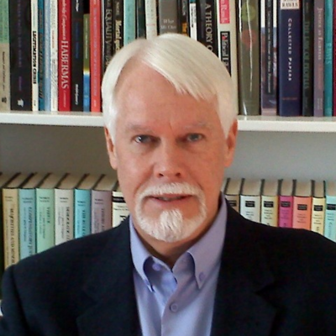
The Particularity Problem
Particularity problem
If I have an obligation to comply with the law, it is an obligation to comply specifically with the laws of my political community
Duty to promote justice is not this
specific
Reply 1
Must political obligation be
particular?
Reply 2
Our natural duty to justice must
start somewhere

Slide 13
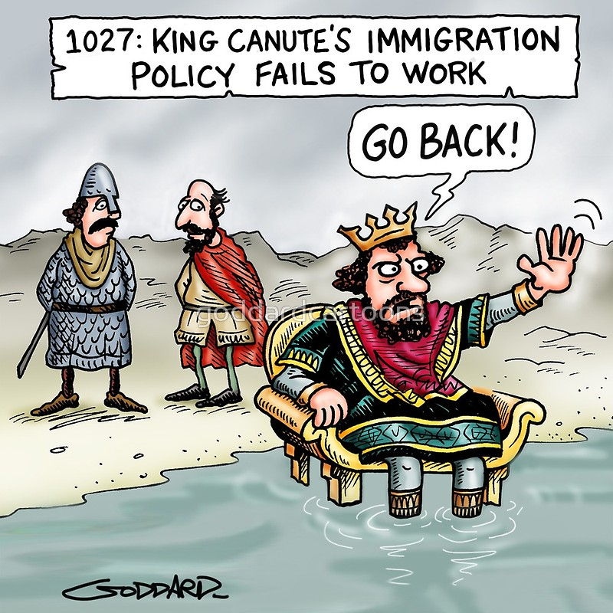
Negligible Effect problem
The effect of my actions on furthering the end of justice is negligible

Slide 14
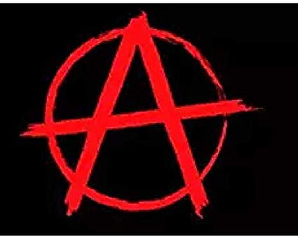
Next week: anarchy!

