Slide 1
Equality of opportunity
Lecture 1
Meritocracy and Fairness

Slide 2
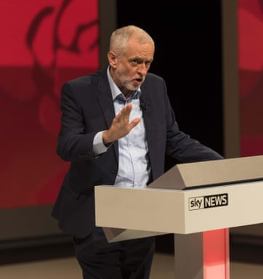
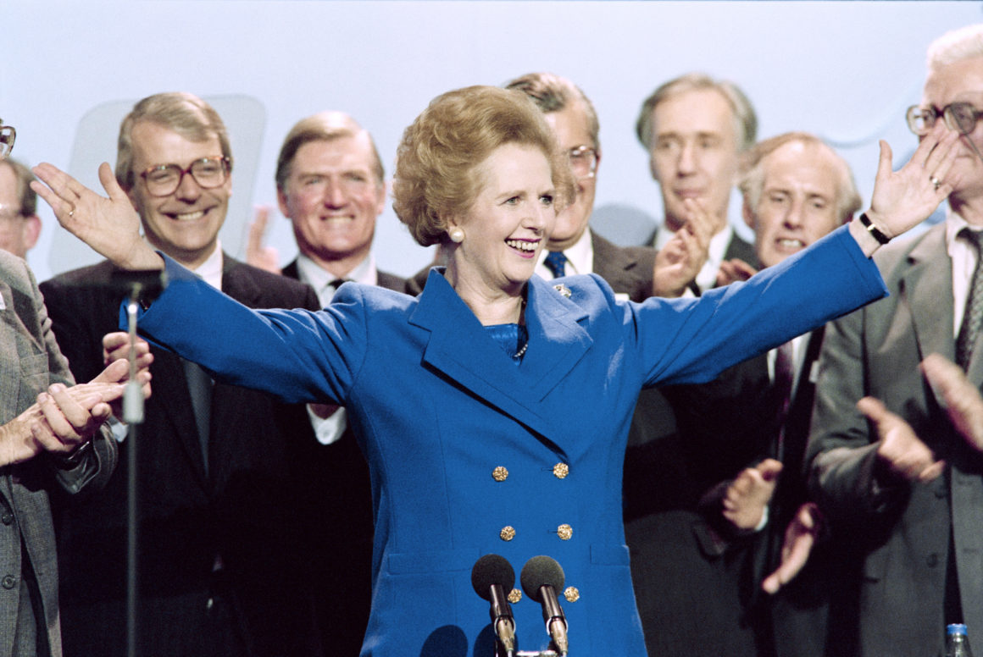
A Popular Principle
Our Party is the Party of equality of opportunity.
— Margaret Thatcher
(1975)
We won’t be ashamed of saying: we want an inclusive society with equality of opportunity for all
—Jeremy Corbyn (2016)

Slide 3
meritocracy

Slide 4
What is meritocracy?
Meritocracy: Desirable jobs or positions should be offered to the best-qualified applicants through competitions that no one is excluded from entering
AKA: “careers open to talents” (Rawls, A Theory of Justice)
Proponents: David Miller (‘Deserving Jobs’), George Sher (‘Qualifications, Fairness, and Desert’)
“Best-qualified”: a qualification for position X is an ability or disposition that contributes positively to performing the task

Slide 5
Justification I: Efficiency
The efficiency argument: Giving jobs and positions to the best qualified means that each job will be performed by those most capable of performing it
This is a forward-looking and consequentialist justification
Problem: consequentialism will sometimes lead us to hire those who are not the best qualified
E.g. John and his wealthy grandmother
vs. Jane the expert mechanic

Slide 6
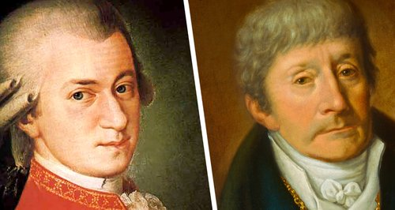
Justification II: Rewarding Past Performance
The past-performance argument: Hiring the best qualified is a way of rewarding people for their past performance
This is a backward-looking justification
Problem: it is possible to be the best qualified for a certain job without having performed the job well previously (see David Miller, ‘Deserving Jobs’)
Example: Salieri vs Mozart

Slide 7
Justification III: Respect for Agency
The respect argument:
“When we hire by merit, we abstract from all facts about the applicants except their ability to perform well at the relevant tasks. By thus concentrating on their ability to perform, we treat them as agents whose purposeful acts are capable of making a difference in the world.” (Sher, ‘Qualification, Fairness and Desert,’ p. 119-120).
Problem 1: Is selecting according to qualifications the only way of respecting agents? We could also select according to need
Problem 2: The idea of respect may be too formal to help us here

Slide 8
Justification IV: Desert and Fairness
In a fair society, jobs would be allocated to workers whose actual contribution-value is proportional to their salary
Fairness requires that our hiring practices maximise the chances of our society being fair in the way described in 1
The best-qualified candidate is most likely to perform the job perfectly
A person performs a job perfectly iff the value of their work is equal to the value of the designed contribution of the job
The value of the work done by the best-qualified candidate is most likely to equal the value of the designed contribution of the job. (from 3 and 4)
Grant that in our society jobs are created with salaries proportional to their designed contribution-value
The contribution-value of the work done by the best-qualified candidate is, if hired, most likely to be proportional to their salary (from 5 and 6)
We ought to hire the best-qualified candidate (from 2 and 7)

Slide 9
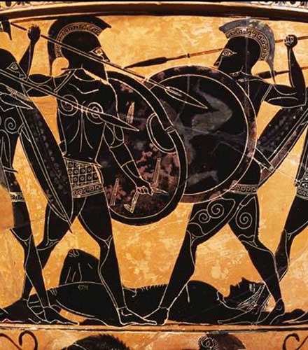
Objection to Meritocracy
The Unfairness Objection
(Bernard Williams, ‘The Idea of Equality’, John Rawls, A Theory of Justice, sections 11 and 12)
In societies with significant inequality, people start with unequal opportunities to develop qualifications
Fairness at the level of competition for a position fails to respond to this deeper unfairness
E.g. Bernard Williams’ Warrior Class Case

Slide 10
FAIR EQUALITY OF OPPORTUNITY (FEO)

Slide 11
What is Fair Equality of Opportunity (FEO)?
FEO combines two principles:
Meritocracy: Desirable jobs or positions should be offered to the best-qualified applicants through competitions that no-one is excluded from entering
Fair Background: Access to qualifications should not be influenced by individuals’ socioeconomic background
“Those with the same level of [natural] talent and ability, and the same willingness to use them, should have the same prospects of success regardless of their initial place in the social system” (Rawls, Theory of Justice, section 12)

Slide 12
FEO: further issues
Benefits of FEO
Seems fairer than meritocracy, by dealing with unfair distribution of access to qualifications
FEO retains the importance of individual responsibility
Possible policy recommendations: public funding for schools, redistributive taxation, good social-care for children
The issue of priority: which should take priority: Meritocracy or Fair Background?

Slide 13
The Family Objection
Family can have a strong influence on capacity to develop qualifications
One consequence of FEO could be extreme regulation (or abolition?) of the family
Is that a problem?
Yes: at the least it is a radical interference with individual liberty
No: Plato’s Republic, feminist critique of the family

Slide 14
The (Return of) the Unfairness Objection
The Unfairness Objection to FEO
FEO allows natural talents to influence access to qualifications, jobs, and social positions
But natural talents are:
Unearned
Unequally distributed
Answer 1: Complement FEO with a third principle (e.g. Rawls’ difference or maximin principle)
Answer 2: Natural inequalities are morally different to social inequalities
Answer 3: Abandon FEO in favour of a fairer theory of equality of opportunity (next week)

