Slide 1
Equality of opportunity
Lecture 2
Luck and Scepticism

Slide 2
Recap: Meritocracy and FEO
Meritocracy: desirable jobs or positions should be offered to the best-qualified applicants through competitions that no one is excluded from entering.
Problem: access to qualifications
Fair Equality of Opportunity: Access to qualifications should not be influenced by individuals’ socioeconomic background.
Problem: FEO allows natural talent to affect access to qualifications, jobs, and social positions. But since natural talent too is undeserved, this might seem unfair.

Slide 3
Luck egalitarianism

Slide 4
Defining Luck Egalitarianism
Luck Egalitarianism: Fairness requires that we redress inequalities (in welfare) that result from luck rather than from choices
LE broadens the idea of equality of opportunity in 2 ways:
removes unequal opportunities resulting from unchosen social background and differences in natural talent.
Typically, focuses on equal opportunities for welfare, not just jobs and social positions.

Slide 5
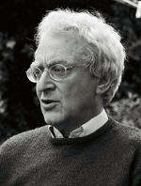
The Appeal of Luck Egalitarianism
LE captures two important intuitions about fairness:
It is unfair for people to be disadvantaged through no fault of their own.
Fairness requires that people be held accountable for their choices.
Other names: ‘Responsibility-
sensitive egalitarianism’,
‘Equality of Opportunity for
Welfare’
Shlomi Segall
GA Cohen

Slide 6
Apples and Oranges

Slide 7
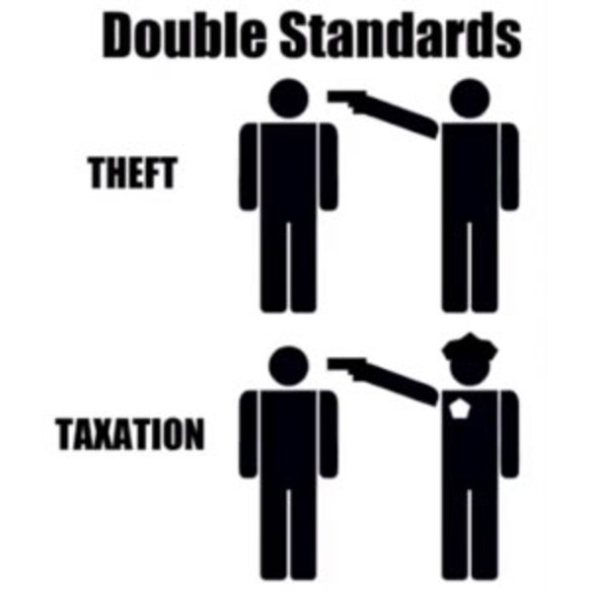
Objection I: Liberty
The liberty objection: LE requires extensive state interference with individuals’ lives to eliminate the impact of unchosen social and natural inequalities.
Reply 1. This isn’t as bad
as it sounds (e.g.
redistributive taxation)
Counter: slippery slope?
Reply 2. LE enhances the
liberty of the unlucky

Slide 8
Objection II: Efficiency
The efficiency objection: equalizing opportunities for welfare may make everyone worse off
Redistributive taxation could disincentivize hard work for the talented and qualified.
Giving jobs to the less qualified could lead to important social functions being performed poorly
Reply: Impose an efficiency-constraint on LE
Counter: this reduces the moral significance of LE (why not just maximise efficiency?)

Slide 9
Objection II: Efficiency
The efficiency objection: equalizing opportunities for welfare may make everyone worse off
Redistributive taxation could disincentivize hard work for the talented and qualified.
Giving jobs to the less qualified could lead to important social functions being performed poorly
Reply 2: fairness should not be restricted by the attitudes of citizens
Counter 2: the more productive deserve greater reward

Slide 10
A Test of Moral Intuition
What do we do?
A – distribute the benefits equally
(e.g. all increase income by 10%)
B – distribute benefits proportional to productivity increase
(e.g. increase income for best able by 15%
and increase income for least able by 5%)
New technology (e.g. holograms, droids)
Everyone works to the best of their ability
Increased productivity for all
Some increase their productivity more than others
Distribution of benefits of increased productivity?

Slide 11
Objection III: Epistemic difficulties
The epistemic objection: LE requires an impossible level of knowledge
We need to know:
Current levels of well-being for each person;
Whether current levels of well-being result from choices for which people are responsible;
What we are responsible for (raises difficult questions about responsibility, free will, and determinism).

Slide 12
Objection IV: Equality
The equality objection (aka: the abandonment objection):
LE abandons those who are disadvantaged because of choices they made
Example: Reckless motorcyclist
Reply 1: Legally prohibit bad
choices?
Reply 2: Insure against bad choices
Example 2: Impoverished carers

Slide 13
Scepticism about equality of opportunity

Slide 14
Problem 1: A Dilemma
Chambers (‘Each Outcome is Another Opportunity’)
There are two ways to equalize opportunities:
Opportunities are equalized up to a single moment in people’s lives, the Moment of Equal Opportunity.
Problem: inequalities after the MEO are unjustified
Opportunities are equalized throughout people’s lives.
Problem: insurmountable epistemic and efficiency-related difficulties.

Slide 15
Problem 1: A Dilemma
Chambers (‘Each Outcome is Another Opportunity’)
There are two ways to equalize opportunities:
Opportunities are equalized up to a single moment in people’s lives, the Moment of Equal Opportunity.
Problem: inequalities after the MEO are unjustified
Reply: there is no ethical inconsistency if the MEO is perfectly realised
Counter: a truly perfect MEO is impossible

Slide 16
Problem 2: A useless label
Radcliffe-Richards
(‘Equality of Opportunity’):
Theories of EoO are all too
different for the category to be
meaningful
Reply: Fairness as the unifying idea?
But: luck egalitarianism does have a different focus (welfare) than the other theories of equality of opportunity (jobs and social positions).

