Slide 1
Political obligation
Week One: Hobbes and the State of Nature
Matt Bennett
mpb74@cam.ac.uk
drmattbennett.weebly.com

Slide 2
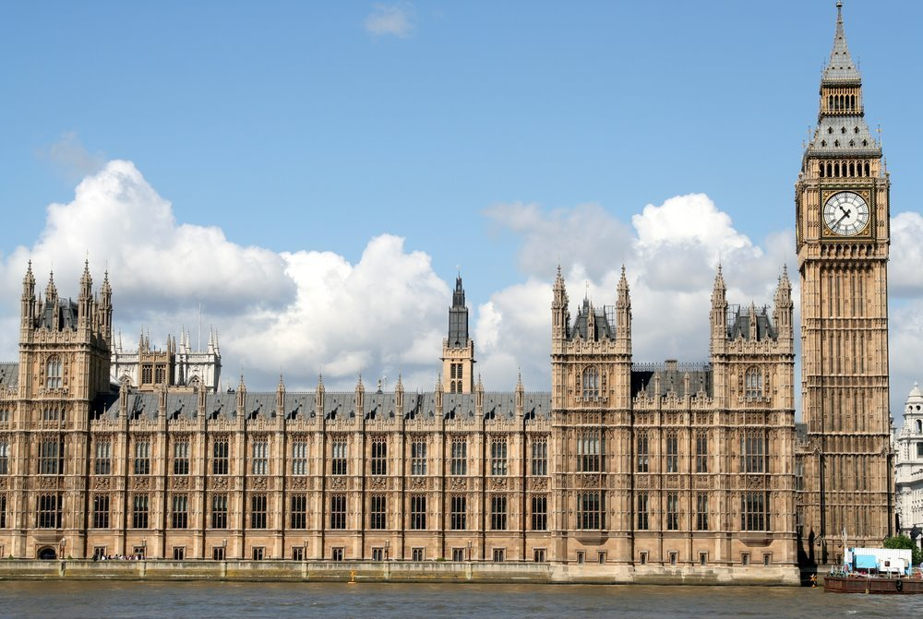
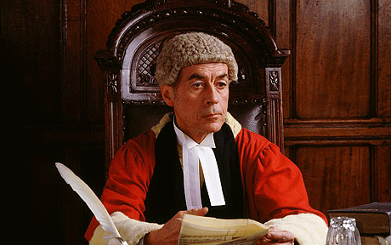
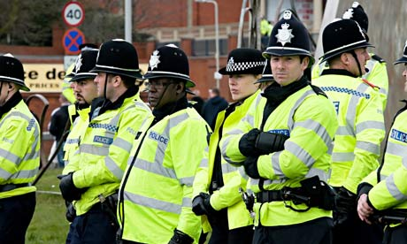
What is political obligation?
What obligations do I have as a citizen?
Obey the state?
Obey the law?
Obey the police?

Slide 3
Should Socrates suffer his execution?

Slide 4
Is civil disobedience always wrong?

Slide 5
The question(s) of political obligation
Do I have an obligation to obey the state and its laws?
Yes: a legal obligation

Slide 6
The question(s) of political obligation
Do I have an obligation to obey the state and its laws?
Yes: a legal obligation
Do I have a moral obligation to obey the state and its laws?

Slide 7
Course structure
Social contract I – Hobbes
Social contract II – Locke and critics of social contract philosophy
Fair play and natural duty
Anarchism

Slide 8
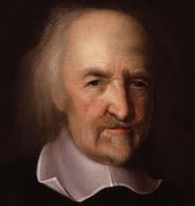
Thomas Hobbes
Thomas Hobbes (1588 – 1679)
Lived through English civil war
(roughly 1642 – 1651)
And execution of Charles I
Royalist in his publications and connections to court
Spent over 10 years in exile in France
Focal text: Leviathan published 1651

Slide 9
Hobbes’ State of Nature
SCARCITY
of resources generates competition

Slide 10
Hobbes’ State of Nature
SCARCITY
EQUALITY
of power means all are vulernable

Slide 11
Hobbes’ State of Nature
SCARCITY
EQUALITY
FEAR
is generated by vulnerability

Slide 12
Hobbes’ State of Nature
SCARCITY
EQUALITY
FEAR
STATE OF WAR
in which all are constantly prepared for violence

Slide 13
Hobbes’ State of Nature
SCARCITY
EQUALITY
FEAR
STATE OF WAR
LAWS OF NATURE

Slide 14
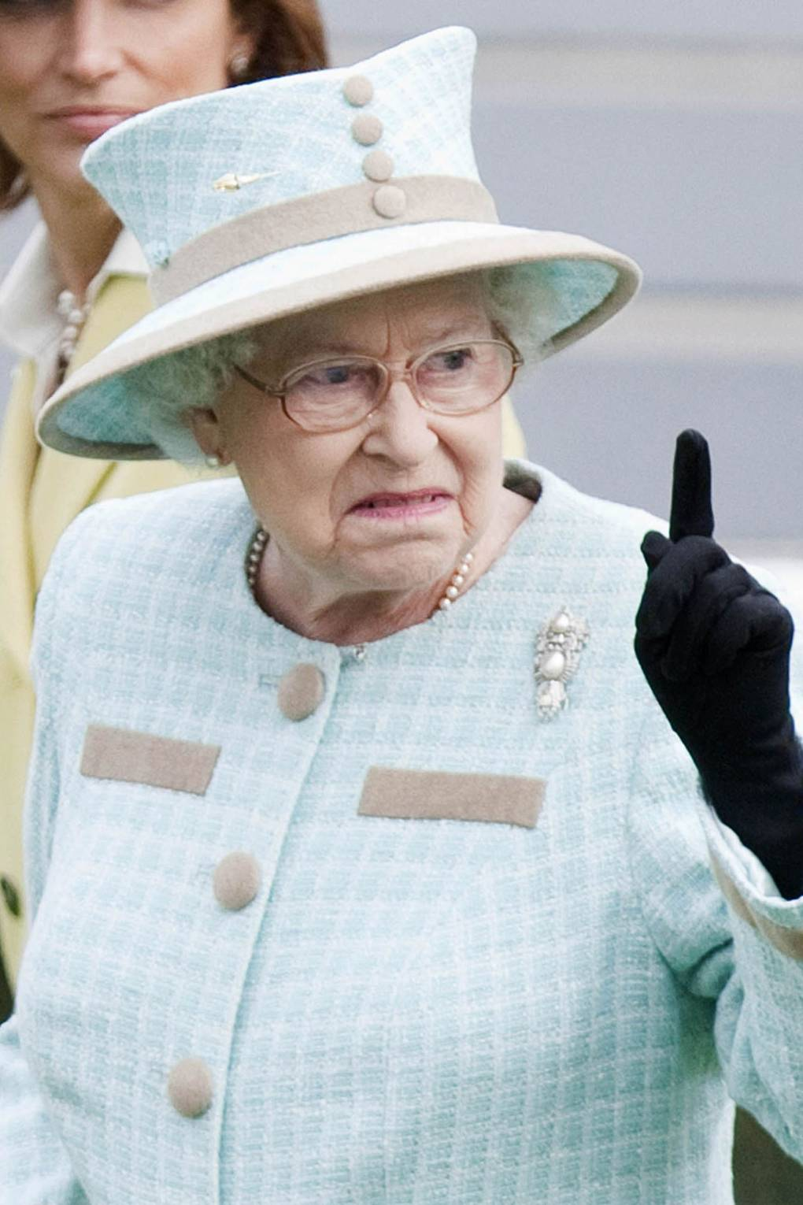
Hobbes’ social contract
The state of nature is a state of perpetual threat of mutual destruction
The fundamental law of nature compels us to find a way out of this situation
The natural way out of this would be to make a peace deal (a contract)
But why would anyone make such a deal if they are suspicious of everyone else?
Collectively authorise an institution with the power to enforce the social contract
THE SOVEREIGN

Slide 15
Hobbes and absolute sovereignty
Hobbes’ argument supports absolute sovereignty
There must be no separation of powers
A separation of powers generates the ever present possibility of conflict
The government must be above the law
Challenges to the government’s authority could lead to civil war
(If you think this is mad, remember the historical context)

Slide 16
What would Hobbes say about Brexit?

Slide 17
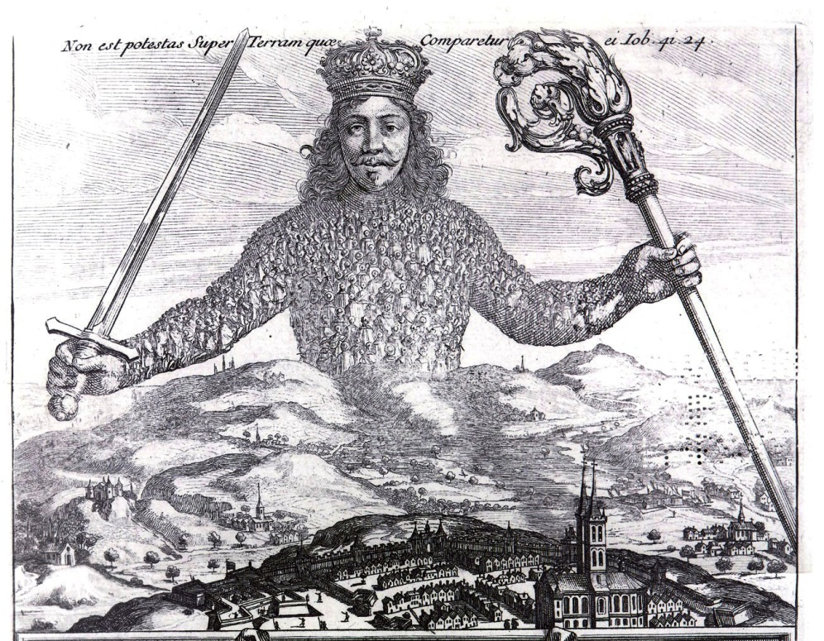
Hobbes and Political Obligation
According to Hobbes, it is rational to submit to the state
The contract is hypothetical
If we in the state of nature, it would be irrational to not establish a social contract
It is rational to submit only to an absolute sovereign

Slide 18
Objections to Hobbes
1. What right does the state have over non-citizens, who have not promised to lay down arms?
Counter: it would be rational for them too to authorise the sovereign, and this is enough for state legitimacy
2. The sovereign is vulnerable to partiality
Counter: better a biased state than no state at all
3. Hobbes replaces a war of all against all with a war of all against the state
Counter: it is in the sovereign’s interest not to attack its citizens

Slide 19
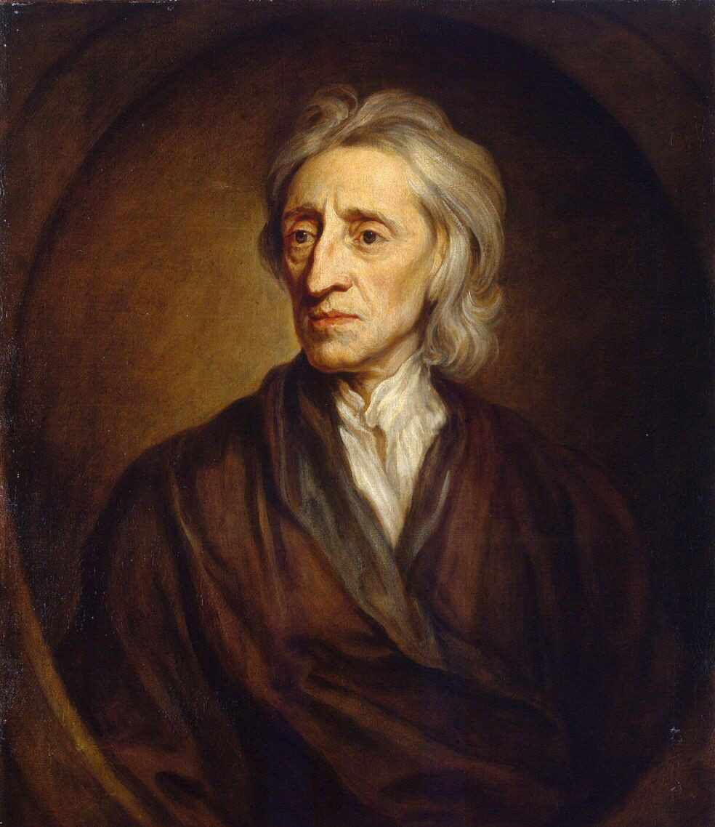
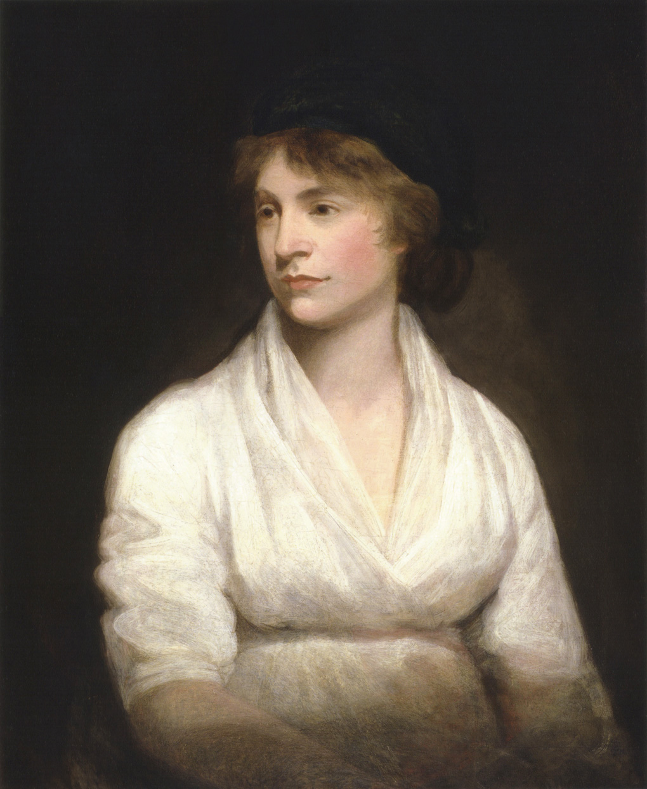
Next week

