Slide 1
Political obligation
Philosophical Anarchism
Matt Bennett
mpb74@cam.ac.uk
drmattbennett.weebly.com

Slide 2
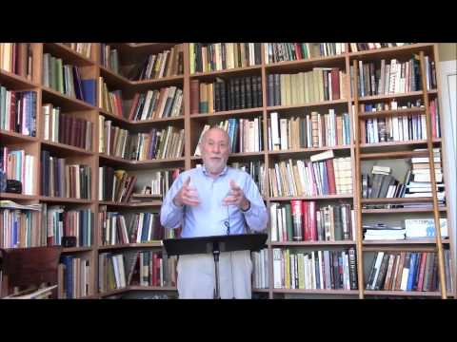
Anarchism

Slide 3
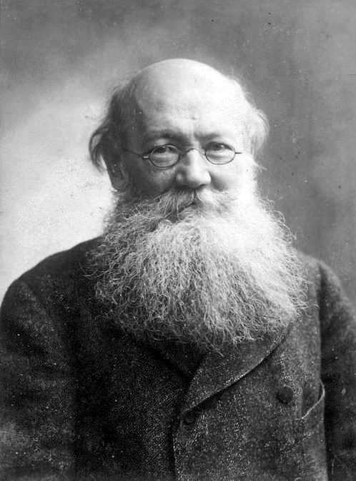
Political Anarchism
The state calls its own violence law, but that of the individual, crime. I say: liberate yourself as far as you can, and you have done your part
– Stirner
MAX STIRNER
PYOTR KROPOTKIN

Slide 4
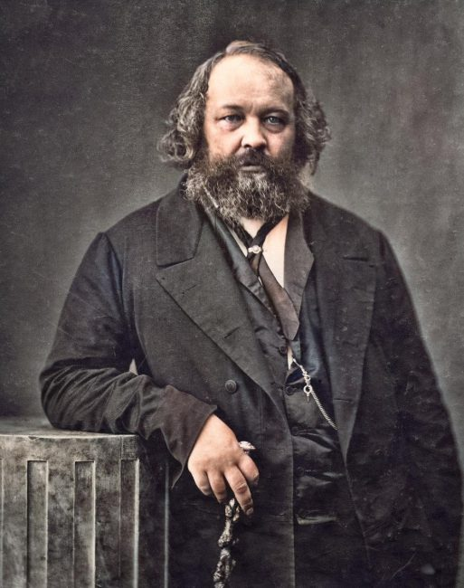
Revolutionary Anarchism
MIKHAIL BAKUNIN

Slide 5
Anarcha-feminism
EMMA GOLDMAN

Slide 6
2 types of philosophical anarchism
A priori PA: a valid argument for the legitimacy of Political Obligation is impossible
e.g. Robert Paul Wolff (more of whom in a moment)
A posteriori PA: a valid argument for the legitimacy of Political Obligation is in principle possible but in practice unachieved (despite millennia of attempts)
e.g. A. John Simmons, MBE Smith, Leslie Green

Slide 7
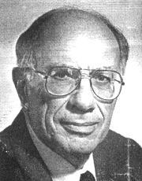
Robert Paul Wolff’s a priori anarchism
2 fundamental concepts
Authority:
A exercises authority when B does some-
thing commanded by A solely because
A commanded it
Contrast with e.g. muggers and sailors
Autonomy:
is an ethical goal, not a property
achieved when we “take responsibility”
taking responsibility provides a moral law for me to follow that I have identified for myself

Slide 8
Robert Paul Wolff’s a priori anarchism
2 fundamentally opposed concepts
Obligation of autonomy: We are obligated
to take responsibility for our actions,
thereby obligated to strive for autonomy
Authority: commands followed through obedience, not moral scrutiny
Wolff: If we submit to authority, we fail to meet our obligation to strive for autonomy

Slide 9
Objections to Wolff - Authority
Even in ordinary, non-coerced promise making I must sacrifice autonomy insofar as I bind myself by the promise
Therefore Wolff’s rejection of authority also excludes ordinary promise making
Reply
There is a difference between
following a command because it commands what has been promised
following a command because it is authoritative
Wolff rejects the latter, not the former

Slide 10
Objections to Wolff - Autonomy
John Horton has argued that Wolff does not give us enough reason to think that we have a categorical duty to strive for autonomy
Authority sometimes means we defer responsibility for deciding right action to political institutions. This is only a problem if we are obligated to always take responsibility
Reply:
substitute duty to take responsibility with right to moral status (see Matthew Noah Smith)

Slide 11
A Posteriori Anarchism - Green
The test for theories of PO
Morality: the reason for PO must be moral.
Universality: PO binds all citizens to all laws
Particularity: PO is to a particular State, not to all or any States
Bindingness: PO must bind us even when in conflict with self-interest
Content independence: PO must be independent of the content of the State’s commands

Slide 12
A Posteriori Anarchism - Green
The test for theories of PO
Morality: the reason for PO must be moral.
Prudential theories of PO (e.g. one interpretation of Hobbes) FAIL

Slide 13
A Posteriori Anarchism - Green
The test for theories of PO
Morality: the reason for PO must be moral.
Universality: PO binds all citizens to all laws
Utility theories of PO (e.g. Hume) fail, because they permit exceptions
Fair play theories fail

Slide 14
A Posteriori Anarchism - Green
The test for theories of PO
Morality: the reason for PO must be moral.
Universality: PO binds all citizens to all laws
Particularity: PO is to a particular State, not to all or any States
Natural duty theories fail

Slide 15
Failure of Consent-Based PO
Morality – the reason for PO must be moral.
Content independence – PO must be independent of the content of the State’s commands
Bindingness: PO must bind us even when in conflict with self-interest
Particularity: PO is to a particular State, not to all or any States
Universality: the laws of the State apply equally to all citizens of that State
CONSENT THEORY OF POLITICAL OBLIGATION
PASSES
BUT ONLY IN AN IMPLAUSIBLE FORM

Slide 16
Criticisms of a posteriori anarchism
What changes if I am not subject to
Political Obligation?
Simmons: not much!
we may obey the state if we wish
sometimes we should obey the state because the plans of others depend on us doing so (e.g. tax payments)
Objection 1: without political obligation, the price paid by a citizen cannot be demanded solely on the grounds of the inconvenience of non-payment (Senor)

Slide 17
Criticisms of a posteriori anarchism
What changes if I am not subject to
Political Obligation?
Simmons: not much!
we may obey the state if we wish
sometimes we should obey the state because the plans of others depend on us doing so (e.g. tax payments)
Objection 2: philosophical anarchism undermines a lot more than this – am I even a citizen? (see e.g. Horton)

Slide 18
Are all philosophers anarchists?
I obey authority when the command of another is a reason for me to act without my enquiring about the value of what is commanded.
An anarchist would never obey the authority of the State.
A philosopher asks why we should obey the State’s authority: “what is the reason for doing what the State commands?” This in enquiring about the value of the State’s commands.
Even if the philosopher argues in favour of following the State’s commands, this cannot be obedience to authority because it is based on the value of the commands.
Conclusion: Philosophers are anarchists!

