Slide 1
Political obligation
Week Two: Consent and its critics
Matt Bennett
mpb74@cam.ac.uk
drmattbennett.weebly.com

Slide 2
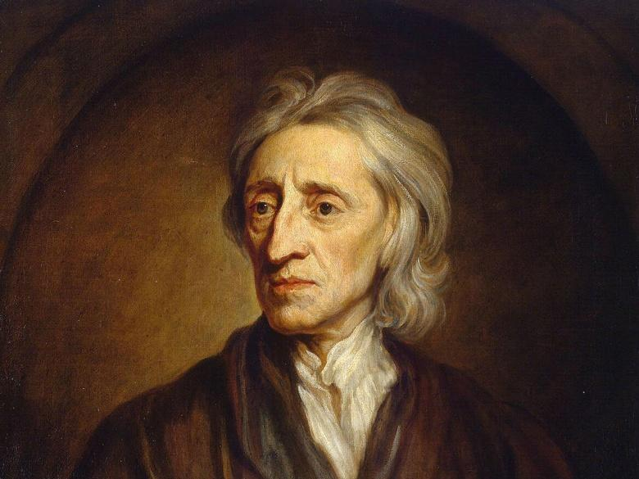
John Locke
John Locke
(1632 – 1704)
Lived through
English civil war
and period of deep political instability until roughly 1690
Committed Parliamentarian and Whig by association
Focal text: Two Treatises of Government
(Second treatise) published 1689

Slide 3
Locke’s theory
Features of the state of nature:
Law of nature – moral equality
Universal right to enforce the law of nature
Disagreements about the law of nature risk state of war
Benefits of establishing the state:
A codification of the law to reduce disagreement about it
An objective authority to arbitrate disagreements
An authority with power to enforce objective judgements

Slide 4
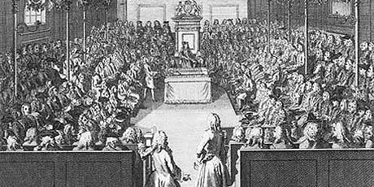
Locke’s ideal state
Separation of powers
Sovereign
Hereditary assembly
Elected assembly
Constraint by law
State power is fiduciary

Slide 5
Defining the state of nature
Def1: Person A is in the state of nature if and only if A lives under no authority to settle disputes

Slide 6
Defining the state of nature
Def1: Person A is in the state of nature if and only if A lives under no authority to settle disputes

Slide 7
Defining the state of nature
Def1: Person A is in the state of nature if and only if A lives under no authority to settle disputes
Def2: A is in the state of nature if and only if A is not a member of a legitimate political community

Slide 8
Defining the state of nature
Def1: Person A is in the state of nature if and only if A lives under no authority to settle disputes
Def2: A is in the state of nature if and only if A is not a member of a legitimate political community

Slide 9
Defining the state of nature
Def1: Person A is in the state of nature if and only if A lives under no authority to settle disputes
Def2: A is in the state of nature if and only if A is not a member of a legitimate political community
Def3: A is in the state of nature if and only if A has not voluntarily agreed to join some legitimate political community

Slide 10
Defining the state of nature
Def1: Person A is in the state of nature if and only if A lives under no authority to settle disputes
Def2: A is in the state of nature if and only if A is not a member of a legitimate political community
Def3: A is in the state of nature if and only if A has not voluntarily agreed to join some legitimate political community
Def4: A is in the state of nature if and only if A has not voluntarily agreed to join (or is no longer a member of) some legitimate political community

Slide 11
Defining the state of nature
Def1: Person A is in the state of nature if and only if A lives under no authority to settle disputes
Def2: A is in the state of nature if and only if A is not a member of a legitimate political community
Def3: A is in the state of nature if and only if A has not voluntarily agreed to join some legitimate political community
Def4: A is in the state of nature if and only if A has not voluntarily agreed to join (or is no longer a member of) some legitimate political community
Def5: A is in the state of nature with respect to B if and only if A has not voluntarily agreed to join (or is no longer a member of) some legitimate political community of which B is a member

Slide 12
Hobbes Contra Locke
 | Hobbes | Locke
State purpose | Keep the peace | Objective application of natural law
Model of the state | Absolute monarchy | Constitutional-parliamentary monarchy
Resistance legitimate? | Only when life is threatened | When trust in government breaks down
Role of consent | Hypothetical consent justifies the state | Actual consent justifies the state
Political obligation | PO grounded in rationality | PO grounded in agreement

Slide 13
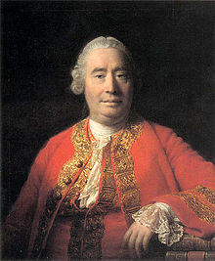
Objections to SCT – David Hume
Legitimate governments are founded on consent?
Plenty of stable governments are founded by conquest or dynasty
If consent is to be found in ancient history, how could it justify modern government?
Tacit consent is no more legitimate than the “tacit consent” of a captive passenger on a ship

Slide 14
Objections to SCT – David Hume
Is Hume missing the point? This depends on the claim of SCT:
If SCT claims
“The state is legitimate because we gave it consent”
Hume’s objection seems to work

Slide 15
Objections to SCT – David Hume
Is Hume missing the point? This depends on the claim of SCT:
If SCT claims
”The state is legitimate because if asked, we would consent to it”
How could we know?

Slide 16
Objections to SCT – David Hume
Is Hume missing the point? This depends on the claim of SCT:
If SCT claims
”The state is legitimate because if asked, we should consent to it”
The historical/sociological objections don’t work
But why is then why is consent important?

Slide 17
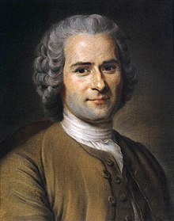
Objections to SCT – Rousseau/Wollstonecraft
Hobbes’/Locke’s state of nature psychology is not universally valid
Life in the state of nature is ”nasty, brutish and short” only if populated by citizens of modern European society
Counter: the case for 17th century
political stability still stands
Counter-counter:
This concedes a lot
Education could lead us away from needing the state

Slide 18
Objections to SCT – Rousseau/Wollstonecraft
Hobbes’/Locke’s state of nature psychology is not universally valid
Life in the state of nature is ”nasty, brutish and short” only if populated by citizens of modern European society
Counter: the case for 17th century
political stability still stands
Counter-counter:
This concedes a lot
Education could lead us away from needing the state

Slide 19
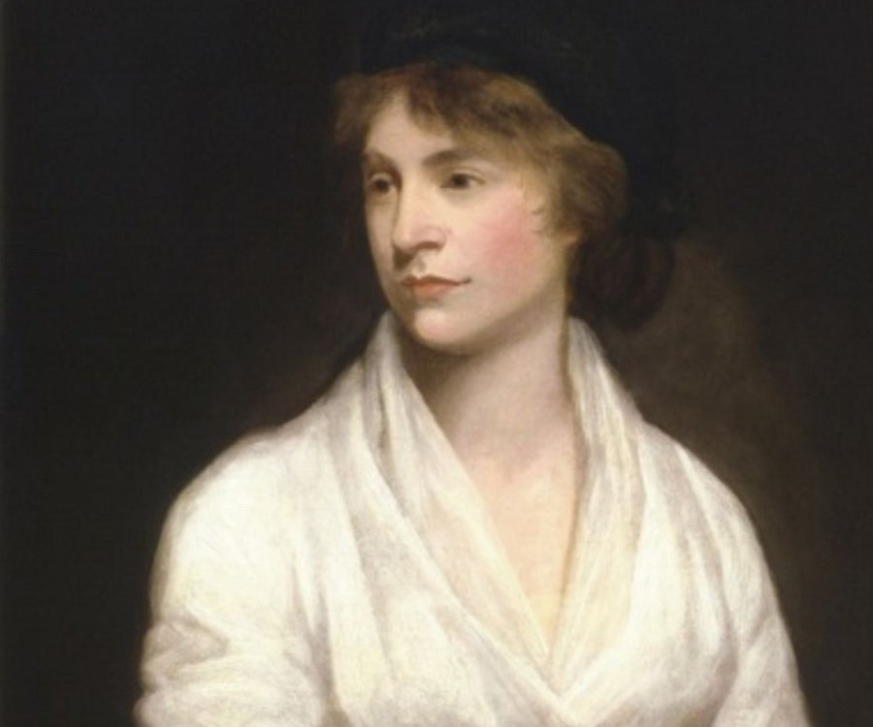
Objections to SCT – Rousseau/Wollstonecraft
Hobbes’/Locke’s state of nature psychology is not universally valid
Life in the state of nature is ”nasty, brutish and short” only if populated by citizens of modern European society
Counter: the case for 17th century
political stability still stands
Counter-counter:
This concedes a lot
Education could lead us away from needing the state

Slide 20
Feminist Objections to SCT
1: SCT is blinkered by a male-dominated perspective
2: SCT justifies obligations imposed on members of society in no position to consent
Counter: SCT could extend its principles to all
3: SCT’s inherent conservatism is incapable of dealing with private injustices
Counter: SCT is compatible with moral principles that would prevent private injustices
Counter-counter: if we need to apply to moral principles anyway, does consent become redundant?

Slide 21
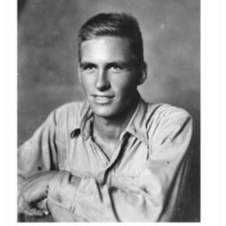
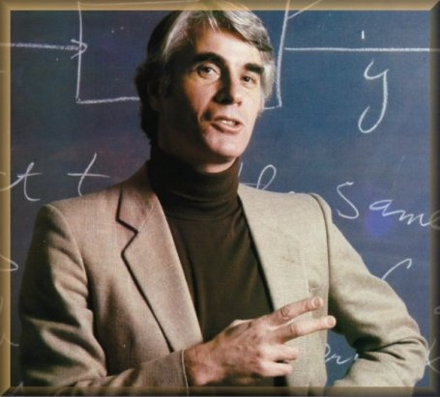
Next week: fair play and natural duty

